Slide 1
Chapter 23: Operational Amplifiers (Part 1)
Op Amp Characteristics & Negative Feedback

Slide 2
Objectives
After completing Part 1 of this chapter, you will be able to:
Understand the characteristics of an amplifier.
List the characteristics of ideal and practical op-amps.
Identify the three input modes of op-amps.
Explain the importance and advantages of applying negative feedback in op-amp circuits.

Slide 3
Introduction
Components like resistors, diodes, transistors are discrete components.
These components are individually packaged and have to be interconnected with each other to form a complete, functional unit.
Linear integrated circuits (ICs) are devices with many discrete components fabricated onto a single chip of semiconductor material
They are packaged in a single component to form a functional circuit.

Slide 4
Introduction
An IC is treated as a single device – i.e. we are interested in what the circuits can do from an external viewpoint.
We have already encountered ICs which are logic gates in Digital Electronics
In this chapter, we will study the operational amplifier IC
Op-amps are among the most versatile and widely used of all ICs

Slide 5
Background on Characteristics of Amplifiers
To understand the characteristics of an ideal op-amp and how they differ from that of a real amplifier, it is necessary for us to understand the following:
The need for an amplifier
Amplification (gain)
Bandwidth
Input & output impedances, and
Distortion

Slide 6
Amplifiers
When watching the news on TV, you increase the volume if you were unable to hear the newscaster’s voice.
When the picture on your TV gets too dark, you increase the brightness control.
In both of these cases, you are taking a relatively weak ac signal and making it stronger (increasing its power).
The process of increasing the power of an ac signal is called amplification.
The circuits used to perform this function are called amplifiers.
The most common types of amplifiers are voltage, current and power amplifiers.

Slide 7
Ideal Amplifier Characteristics
An Ideal Amplifier should have
Infinite voltage gain, A_{V} = ∞
Infinite input impedance, Z_{in} = ∞
Zero output impedance, Z_{out} = 0
Infinite bandwidth, BW = ∞
Zero Distortion (or Input/output relationship = linear)
( i.e. V_{o} is proportional to V_{i} )

Slide 8
Gain
Voltage Amplifier
Amplifiers are circuits that exhibit a property called gain.
Voltage
Gain,
A_{V}
V_{IN}
V_{OUT}
= A_{V} V_{IN}
The gain of an amplifier is a multiplier that exists between the input and output.
E.g., if an amplifier has a voltage gain of 100, the output voltage is 100 times larger than the input voltage under normal operating conditions.
The gain of an amplifier is determined by the amplifier’s circuit component values.

Slide 9
Bandwidth
The gain of the amplifier is not uniformed – it falls after a certain frequency
The range of frequencies over which a useful gain is available is called the bandwidth of the amplifier.
Bandwidth of an amplifier depends on the circuit component values and the type of active component(s) used.
Voltage Gain
A_{V}
0.7071A_{V}
Bandwidth
Frequency
Lower cutoff frequency
Upper cutoff frequency

Slide 10

Input Impedance ($Z_{IN}$)
and Output Impedance ($Z_{OUT}$)
Input
Output
Amplifier
Impedance is a resistance-like property
Output Impedance
Impedance measured
between the output terminals
Input Impedance
Impedance measured
between the input terminals

Slide 11
Distortion
While output signal > input signal, it must also retain the same shape as the input signal – linear input and output relationship
If the shape of the output signal no longer resembles the input signal, the output signal is distorted – this is undesirable.
Undistorted Output
Distorted Output
Amplifier
V_{IN}
V_{OUT}

Slide 12
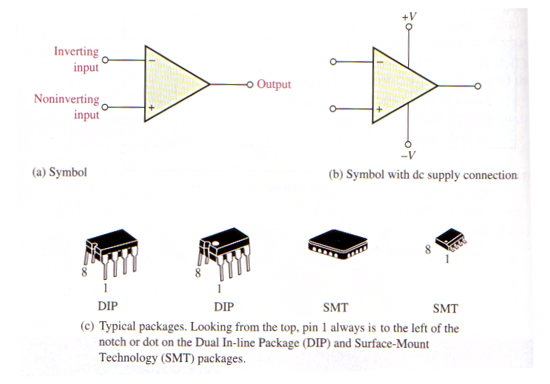
23-1 Introduction to Op Amps
Early op-amps were used mainly to perform mathematical operations like addition, subtraction, integration and differentiation – hence the term “operational”
Symbol and Terminals

Slide 13
Introduction to Op Amps

Slide 14

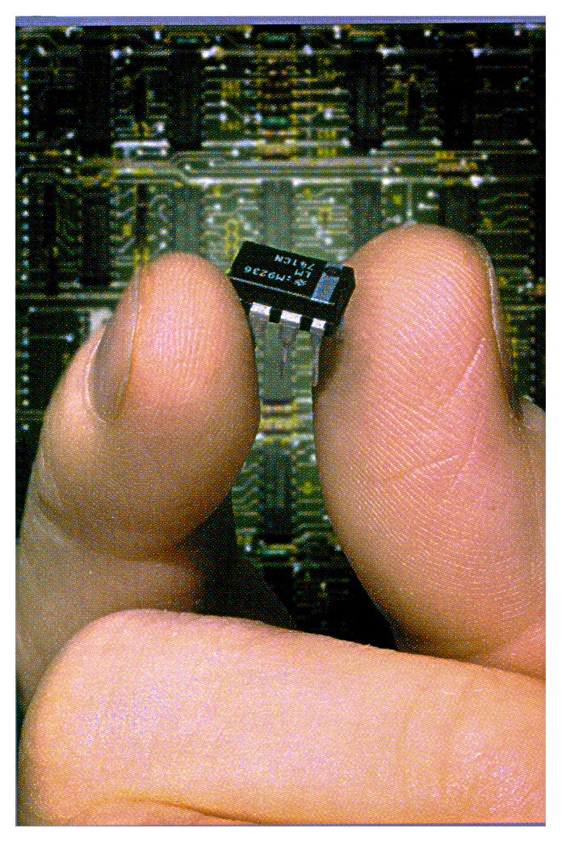
Small size of an
Opertional Amplifier
(op-amp)

Slide 15
The Ideal Op Amp
infinite voltage gain
infinite bandwidth
infinite input impedance
zero output impedance
A_{V} V_{in}
V_{OUT}
V_{IN}
Z_{IN} = ∞
Z_{OUT}= 0
A_{V} = ∞
+
Ideal op-amp representation
Input voltage V_{in} appears between the two input terminals
Output voltage is A_{v}V_{in} , as indicated by the internal voltage source symbol.

Slide 16
The Practical Op Amp
Characteristics of a practical op-amp
very high voltage gain
very high input impedance
very low output impedance
wide bandwidth
A_{V} V_{in}
V_{IN}
Z_{IN}
Z_{OUT}
+
Practical op-amp representation
Peak-to-peak output voltage usually limited to slightly less than the two supply voltages.
Output current also limited by internal restrictions such as power dissipation and component ratings.

Slide 17
23-2 Op Amp Input Modes
Modes of Signal Operation
Op-amp circuits use one of three basic input modes of operation:
- Single-Ended Input
- Differential Input
- Common-Mode Input
+V_{S}
Single-ended input mode has one input connected to the input signal and the other connected to ground.
V_{O}
+
-V_{S}

Slide 18
+V_{S}
The inputs of a differential input circuit are connected to different signal sources.
V_{O}
+
V₁
-V_{S}
V₂
+V_{S}
In the case of common-mode input, both inputs are connected to the same signal source.
V_{O}
+
-V_{S}

Slide 19
Output Voltage
The limit on the output voltage is set by the supply voltages.
The upper limit is called the positive saturation voltage (+Vsat) and it is approximately within 1V of +V.
The lower limit is called the negative saturation voltage (-Vsat) and it is approximately within 2V of -V.
With a supply voltage of +/-15V, +Vsat = +14V and -Vsat = -13V. Therefore Vo is restricted to a symmetrical peak-to-peak swing of +/-13V.

Slide 20

23-3 Op Amp Open Loop Voltage Gain ($A_{ol}$)
The open-loop voltage gain of an op-amp is the internal voltage gain of the device and represents the ratio of output voltage to input voltage when there are no external components.
The open-loop voltage gain is set entirely by the internal design.
Open-loop voltage gain can range up to 200,000 and is not a well-controlled parameter.
Data sheets often refer to the open-loop voltage gain as the large-signal voltage gain.

Slide 21
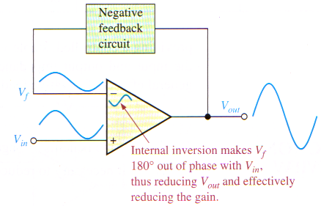

23-4 Op Amp with Negative Feedback ($A_{cl}$)
Negative feedback is one of the most useful concepts in electronics, particularly in op-amp applications.
Negative feedback is the process whereby a portion of the output voltage of an amplifier is returned to the input with a phase angle that opposes (or subtracts from) the input signal

Slide 22
Why Use negative Feedback?
Very high (usually greater than 100,000) inherent open-loop voltage gain of a typical op-amp
Extremely small input voltage drives the op-amp into saturation
For example, assume V_{IN} = 1 mV and A_{ol} = 100,000. Then,
V_{OUT} = V_{in} A_{ol} = (1 mV)(100,000) = 100V
Since the output level of an op-amp can never reach 100 V, it is driven deep into saturation and the output is limited to its maximum output levels, for both a positive and a negative input voltage of 1 mV.

Slide 23
+V_{S}
+V_{saturation}
-1mV
V_{O}
+
-V_{S}
Without negative feedback, a small input voltage drives output to its limits and becomes non-linear
+V_{S}
+1mV
V_{O}
+
-V_{S}
-V_{saturation}
With negative feedback, the closed-loop voltage gain (A_{ol}) can be reduced and controlled so that the op-amp can function as a linear amplifier.

Slide 24
In addition to providing a controlled, stable voltage gain, negative feedback also provides for control of the input and output impedances and amplifier bandwidth.
 | Voltage Gain | Input Impedance | Output Impedance | Bandwidth
Without negative feedback | A_{ol} is too high for linear amplifier applications | Relatively high | Relatively low | Relatively narrow (because the gain is so high)
With negative feedback | A_{ol} is set to desired value by the feedback circuit | Can be increased or reduced to a desired value depending on type of circuit | Can be reduced to a desired value | Significantly wider

Slide 25
Op Amp Configurations with Negative Feedback
The extremely high open-loop gain of an op-amp creates an unstable situation
small input noise voltage amplified such that amplifier is driven out of its linear region
can also cause unwanted oscillations
Open-loop gain parameter of an op-amp can vary greatly from one device to another
Negative feedback creates an effective reduction in gain by taking a portion of the output and applies it back out of phase the input
Closed-loop gain is usually much less than the open-loop gain and independent of it

Slide 26
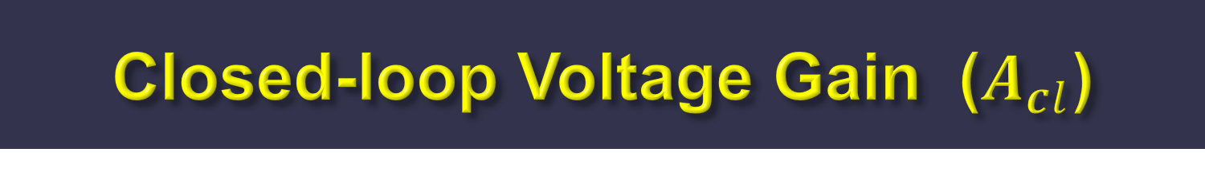
Closed-loop Voltage Gain ($A_{cl}$)
The closed-loop voltage gain
→ voltage gain of an op-amp with external feedback
The amplifier configuration
→ op-amp and an external negative feedback circuit connecting output to the inverting input
The closed-loop voltage gain
→ determined by external component values and can be precisely controlled by them

Slide 27
Effects of Negative feedback
Applying negative feedback to an op-amp gives rise to two important conditions which are:
The input voltages at the inverting and non-inverting terminal are forced to be equal.
i.e. V_ = V₊
I_{IN} = 0
V
V_{S}
Equal
I_{IN} = 0
+
V_{O}
V₊
-V_{S}
The input currents to both the inverting and non-inverting terminals are zero ( ie. no input current flowing into the op-amp).

Slide 28
Summary
A basic op-amp has 2 input terminals (one inverting and the other, non-inverting) as well as one 0utput terminal.
A practical op-amp has very high input impedance, very low output impedance, very high open-loop voltage gain and a very wide bandwidth.
The 3 input modes of an op-amp are :
- single-ended input mode
- differential input mode
- common mode input

Slide 29
Summary
Open-loop op-amp operation does not have external feedback connections
Closed-loop op-amp operation involves external feedback connections.
The output of an op-amp is limited to +Vsat and –Vsat.
The advantages of incorporating negative feedback are :
- closed-loop gain can be controlled
- wider bandwidth
- input and output impedance can be controlled

Slide 30
End of Chapter 23 (Part 1)

